Slide 1
Time Series Forecasting

Slide 2
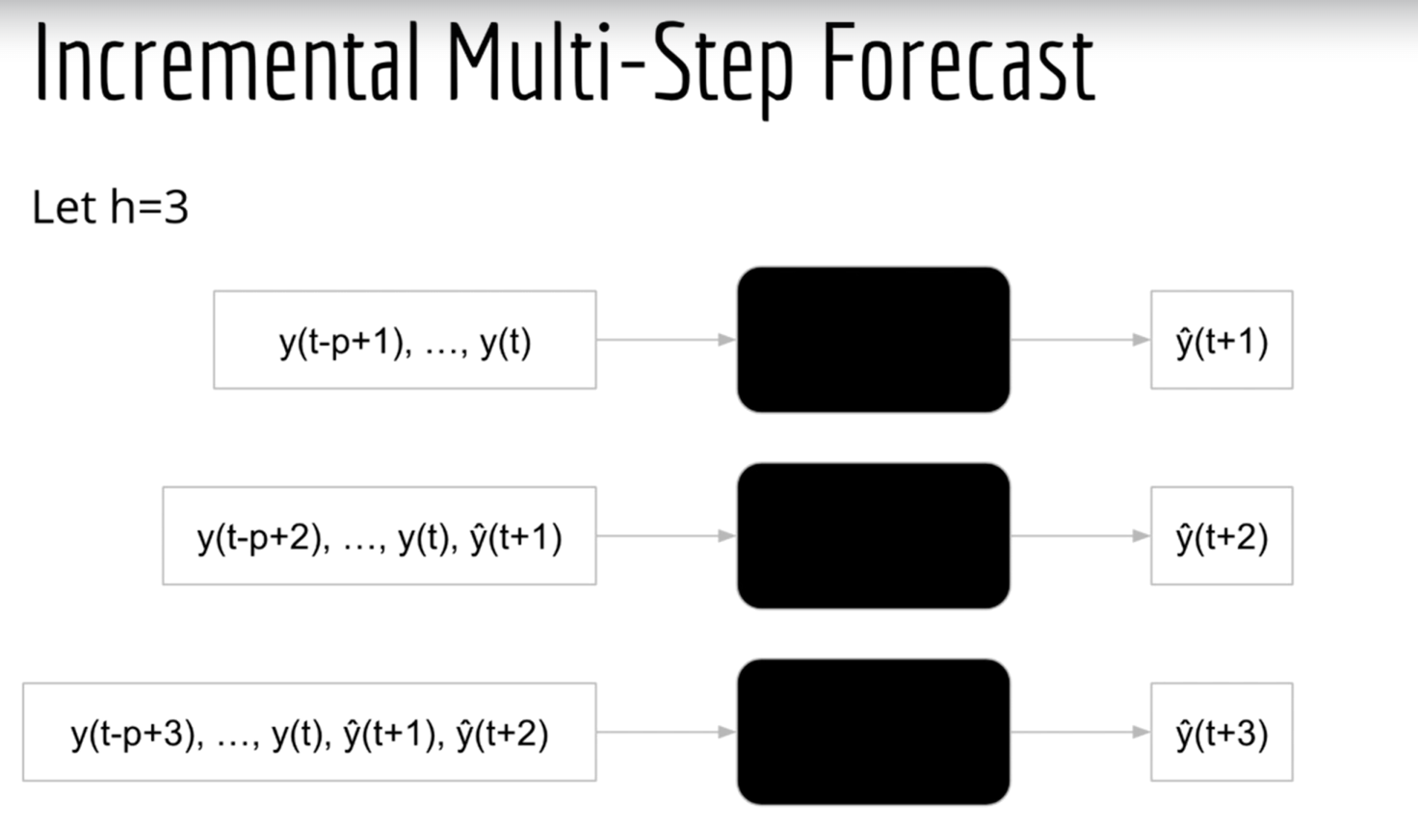
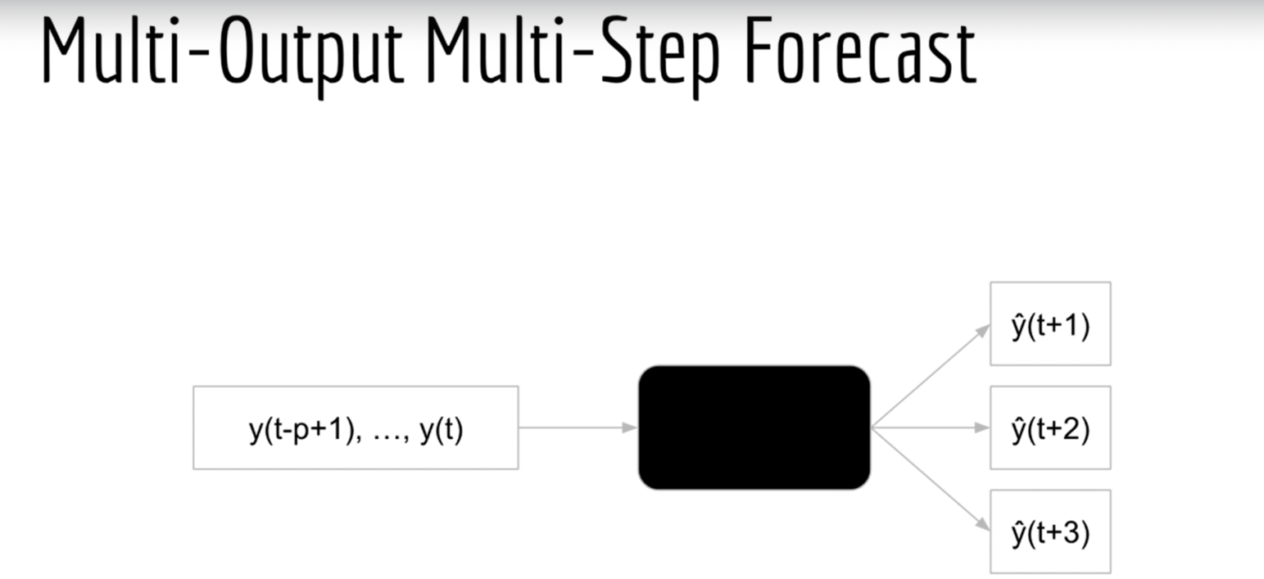
Type of task time series

Slide 3
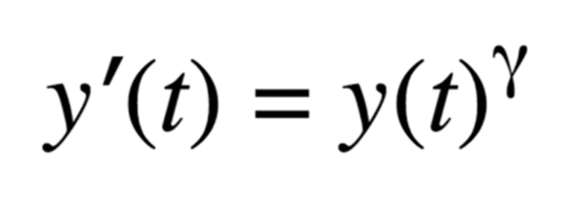
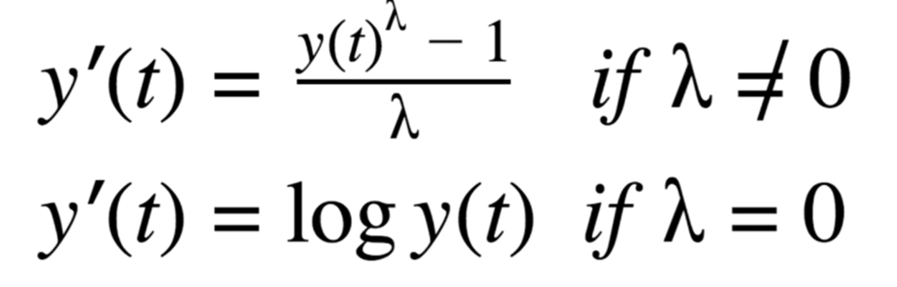
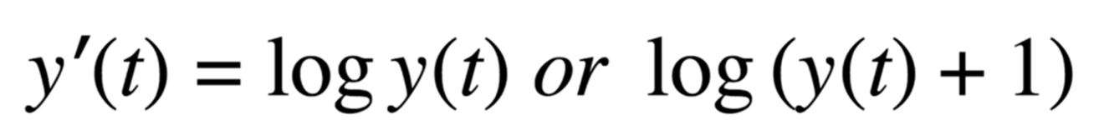
Time series transformation
Power Transform
- Raise all data points to a power (e.g., γ = 1/2)
- Why would you do that? Suppose your data appears to grow quadratically
- By using γ = 1/2, you convert it into a linear trend, which is easy to model! (as you'll soon see)
Log Transform
- "Squashes" the data (similar to power transform, but power transform can do the opposite too)
Often use the log transform by default
Before use make sure data is positive value.
Box-Cox Transform
- Unifies the power and log transforms

Slide 4
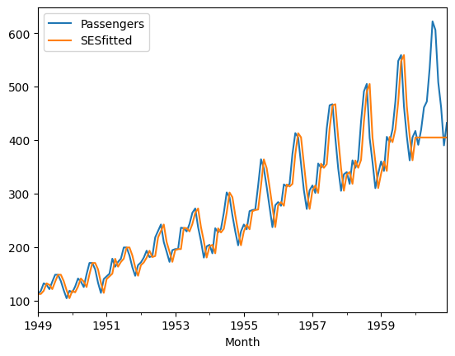
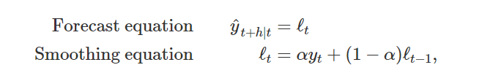
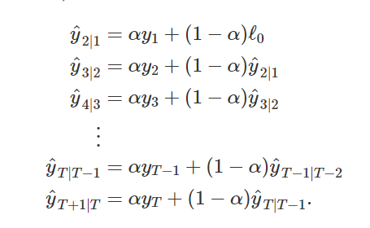
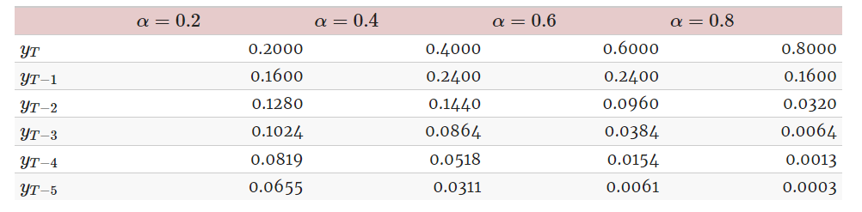
Exponential Smoothing
Simple exponential Smoothing
This method is suitable for forecasting data with no clear trend or seasonal pattern.
Define larger weights to more recent observations than to observations from the distant past.
The rate at which the weights decrease is controlled by the parameter α.
If α is small (i.e., close to 0), more weight is given to observations from the more distant past. If α is large (i.e., close to 1), more weight is given to the more recent observations.

Slide 5
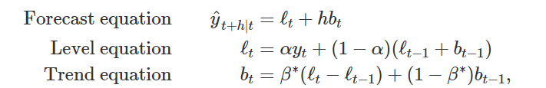
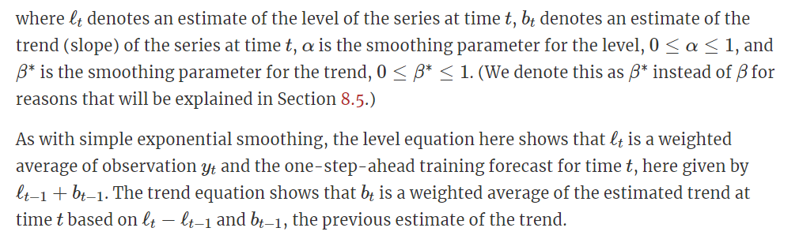
Exponential Smoothing
Holt’s linear trend method
Holt Linear trend model allows for trends
This method involves a forecast equation and two smoothing equations (one for the level and one for the trend)

Slide 6
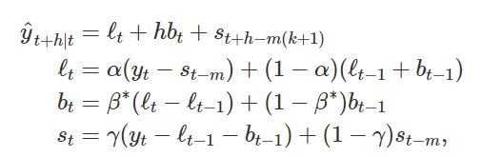
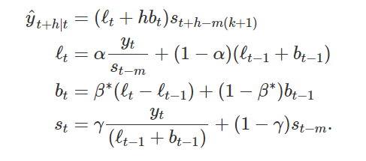
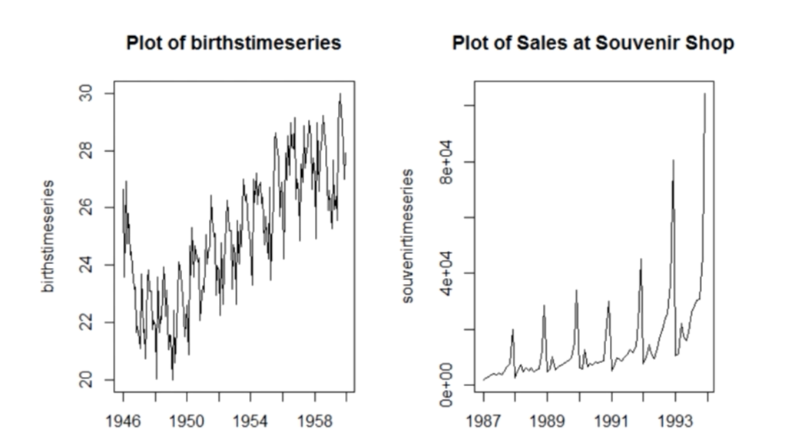
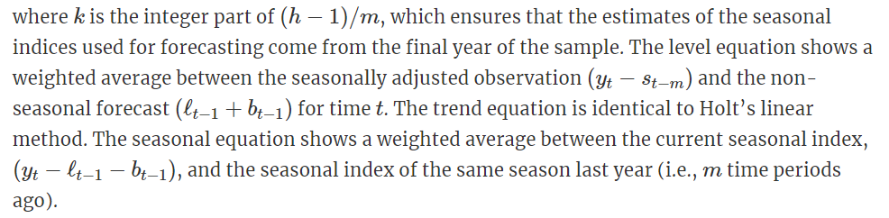
Exponential Smoothing
Holt’s-Winters
Additive Method
Level + trend + seasonal
The additive method is preferred when the seasonal variations are roughly constant through the series
Multiplicative Method
(Level + trend) * seasonal
the multiplicative method is preferred when the seasonal variations are changing proportional to the level of the series
Multiplicative Method
Additive Method
Fit for additive
Fit for Multiplicative

Slide 7
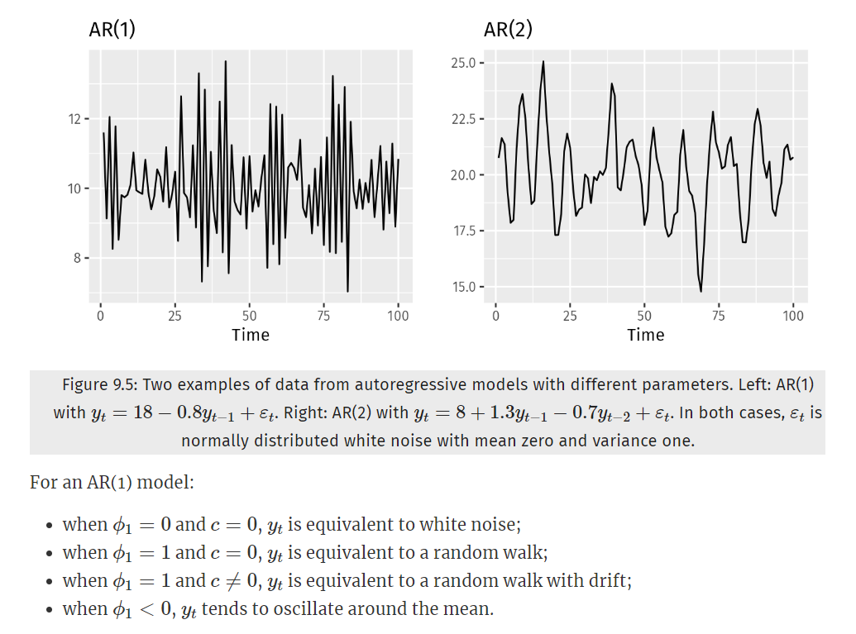
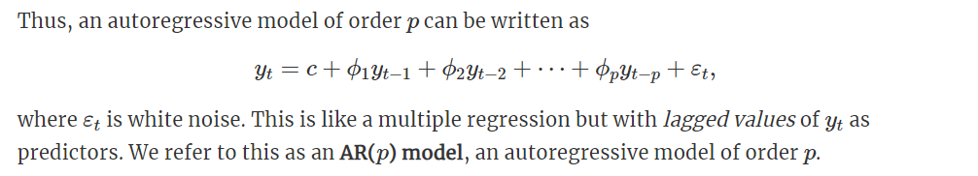
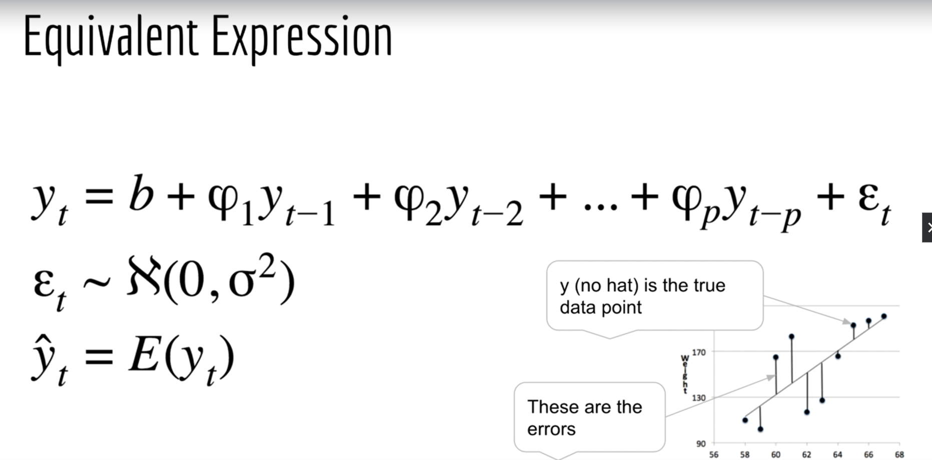
ARIMA
Autoregressive Model – AR(p)
Like Linear regression. Use the past data point in the series to predict the next point
AR(p) = autoregressive model of order p

Slide 8
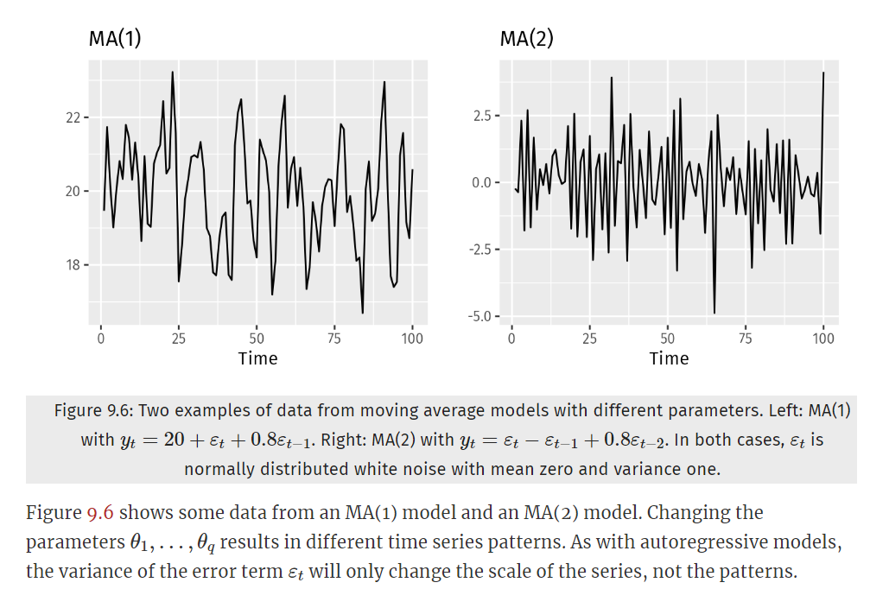
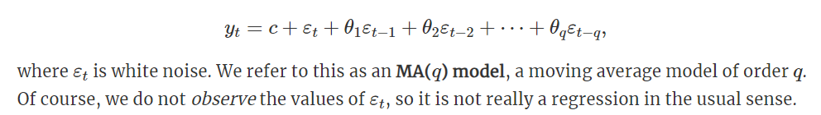
ARIMA
Moving Average Model – MA(q)
Rather than using past values of the forecast variable in a regression, a moving average model uses past forecast errors in a regression
Note: moving average models not be the same with the moving average smoothing

Slide 9
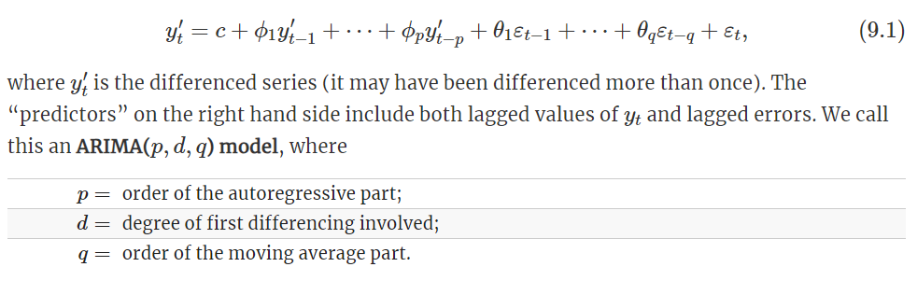
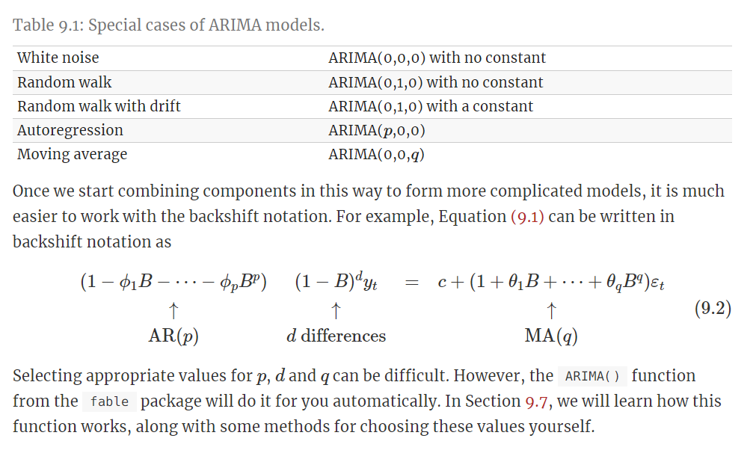
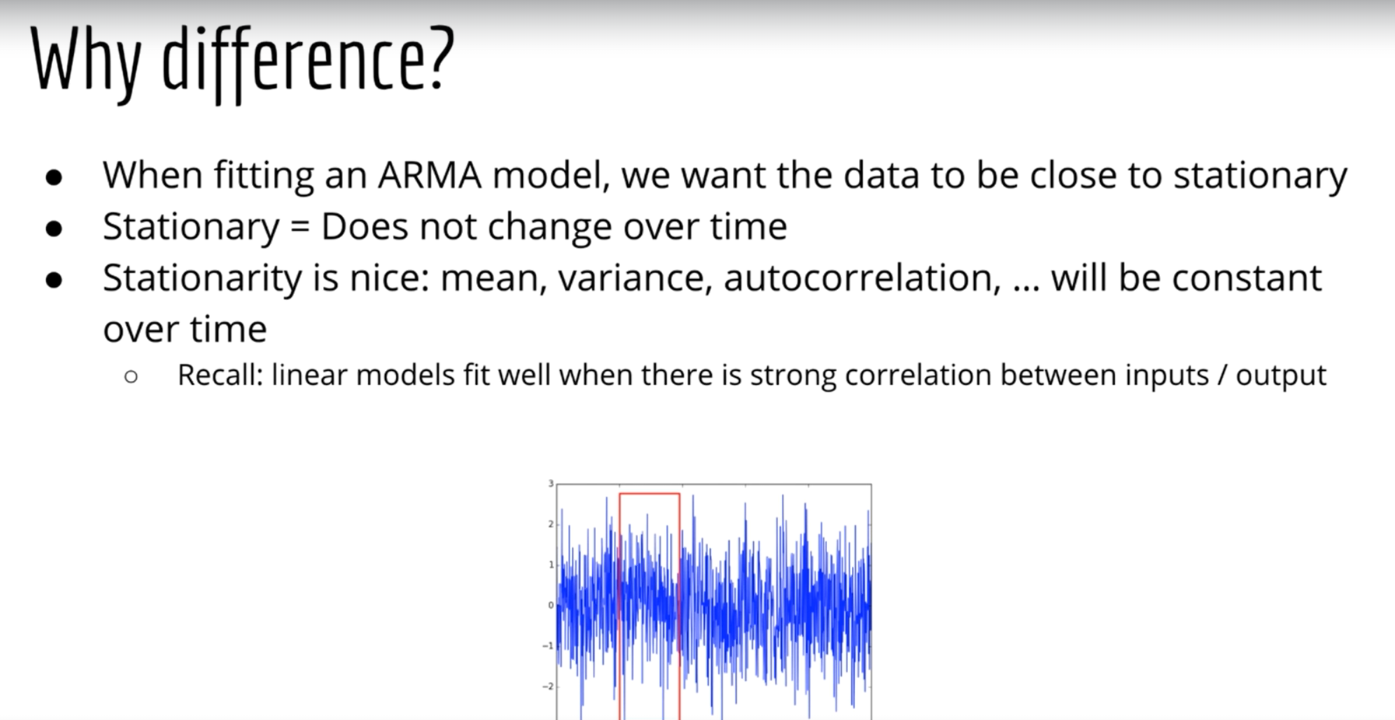
ARIMA
ARIMA (p, d, q)
ARIMA = autoregressive integrated moving average
An I(d) that is stationary after differencing d times
ARIMA(p, d, q) is just a model where we have differenced d times before apply ARMA(p, q)

Slide 10
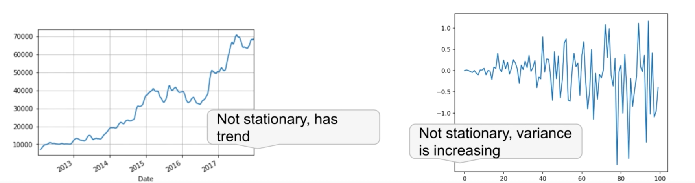
ARIMA
Stationarity
Stationarity will help choose d in ARIMA.
Stationarity mean and variance will always be the same.
Augmented Dicky-Filler Test (ADF Test) for check stationarity
- Null: time series is non-stationary
- Alternative: time series is stationary

Slide 11
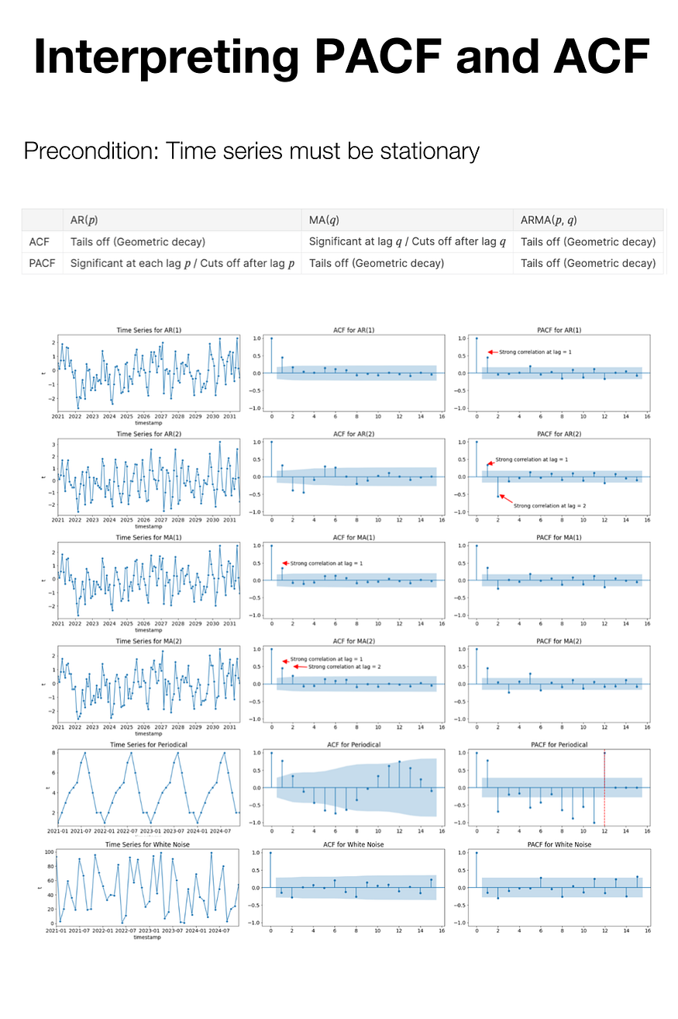
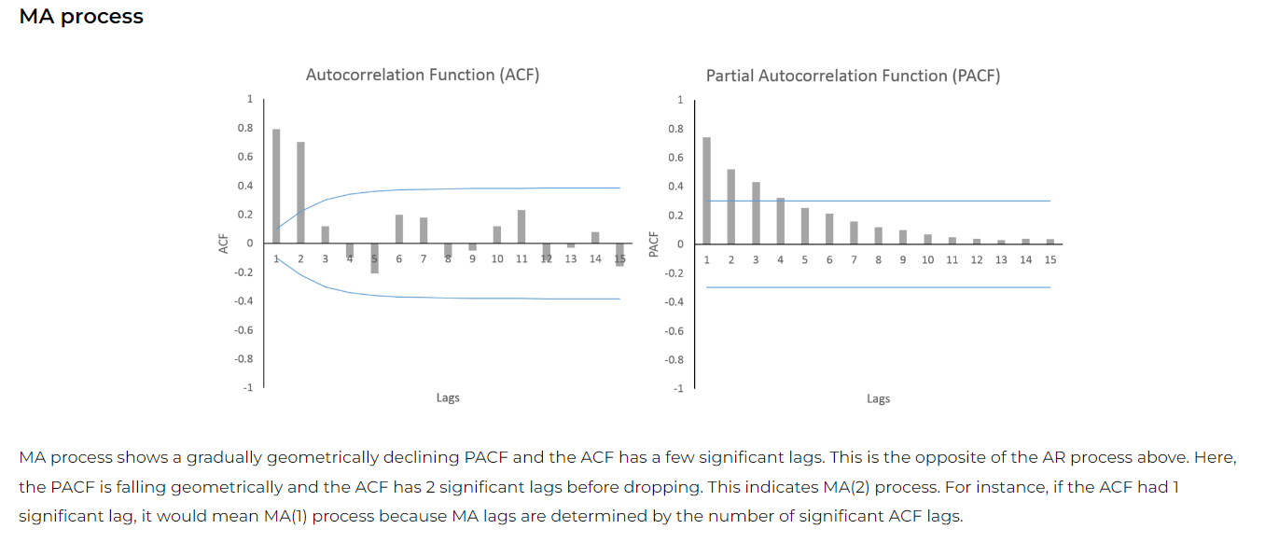
ARIMA
ACF (Autocorrelation Function)
The ACF shows the correlation between the times series and its own lagged values.
It represents a correlation coeffcient batween the series and its past values.
For instance at lag 3 is calculated as the correlation between the series yt and the same series lagged by 3 time periods yt-3.
https://towardsdatascience.com/interpreting-acf-and-pacf-plots-for-time-series-forecasting-af0d6db4061c

Slide 12
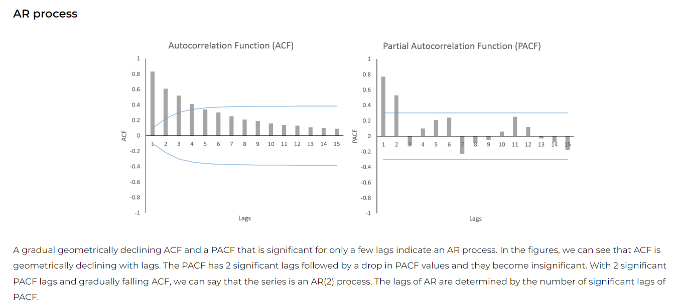
ARIMA
PACF (Partial Autocorrelation Function)
The PACF is estimated by controlling the effects of other lags, generally using linear regression.
The regression includes all the lags between the current time period and the given lag as independent variables.
For example, to estimate PACF at lag 8, we will include 8 lagged variables and the coefficient of the 8° lag will give us PACF at lag 8.
https://towardsdatascience.com/interpreting-acf-and-pacf-plots-for-time-series-forecasting-af0d6db4061c

Slide 13
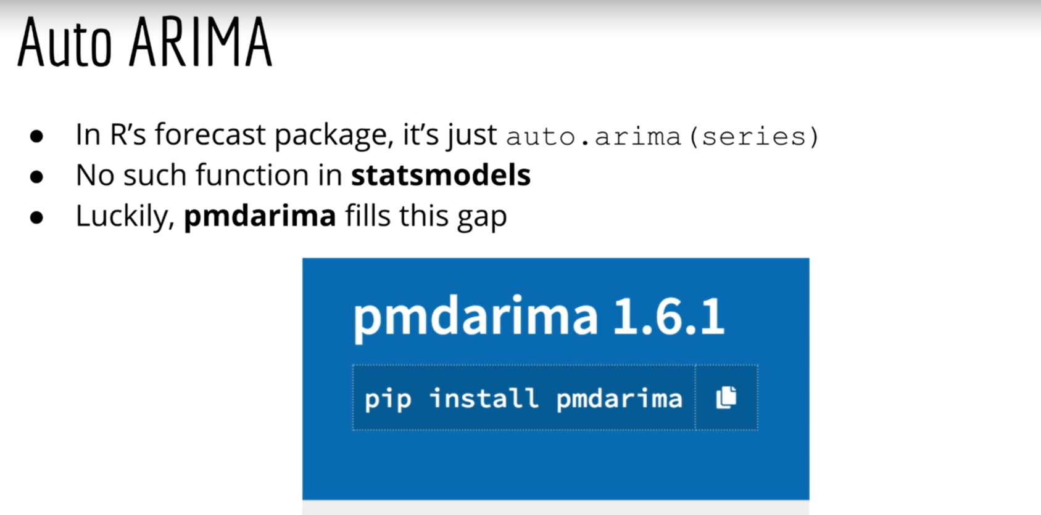
ARIMA
Auto ARIMA

Slide 14
Machine learning method

Slide 15
Deep learning

